Slide 1
Gene Pools

Slide 2
Learning Objectives:
Explain how gene pools are dynamic, with changes in allele frequency caused by mutations, differing selection pressures, random genetic drift, including the founder effect, and changes in gene flow between adjoining groups
Explain how the incidence of genetic diseases in particular populations illustrates the effects of different factors on the dynamics of gene pools, including the incidence of Tay-Sachs disease, thalassemia (α and β) and sickle-cell anaemia

Slide 3
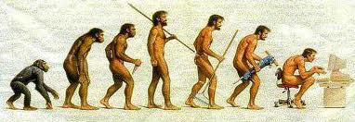
Natural Selection:
This is the process by which a species becomes better adapted to its environment; those individuals with favourable characteristics have a survival advantage and so pass those characteristics on to subsequent generations. This is also a major cause of change to allele frequencies in a gene pool.
This is a major cause of changes in allele frequencies.

Slide 4
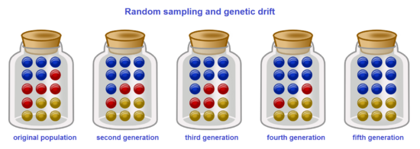
Random Genetic Drift:
The occurrence of characteristics in a population as a result of chance rather than natural selection; occurs only in small populations; also called Sewall Wright effect.
Purely a chance occurrence; for example, having 50 people with brown eyes and 50 people with blue eyes, having a total of 100 balls and selecting 50 at random. In which the result is 30 Blue eyed individuals and 20 brown eyed individuals. Making blue eyes the dominant allele.
There are two sub-categories of Random Genetic Drift that can occur as well (The Founder Effect and Bottleneck Effect).

Slide 5
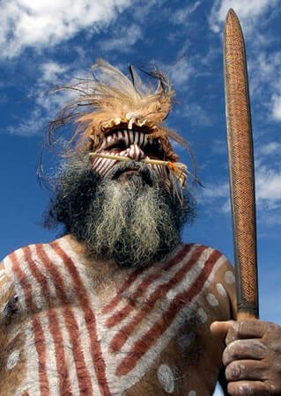
An Example of Genetic Drift:
The indigenous populations on the islands of Mornington and Bentinck experienced this type of shift in allele frequency, where the sea level had risen cutting them off from the mainland, but the Mornington population was still able to get to the mainland with ease. This resulted in the communities on Bentinck Island developing blood group frequencies different to the rest of the aboriginal populations in Australia (showing a high allele frequency for I^{B} and no I^{A}).

Slide 6
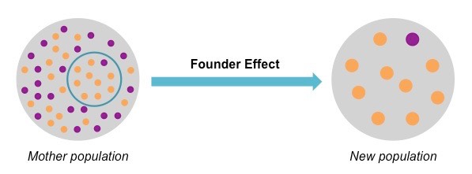
The Founder Effect
A type of genetic drift that occurs when a new population is formed by a small number of individuals; the small size of the sample can cause marked deviations in allele frequencies from the original population.
This effect is not generally a genetic representation of the population it came from. Showing features that are not typical of its homeland population.

Slide 7
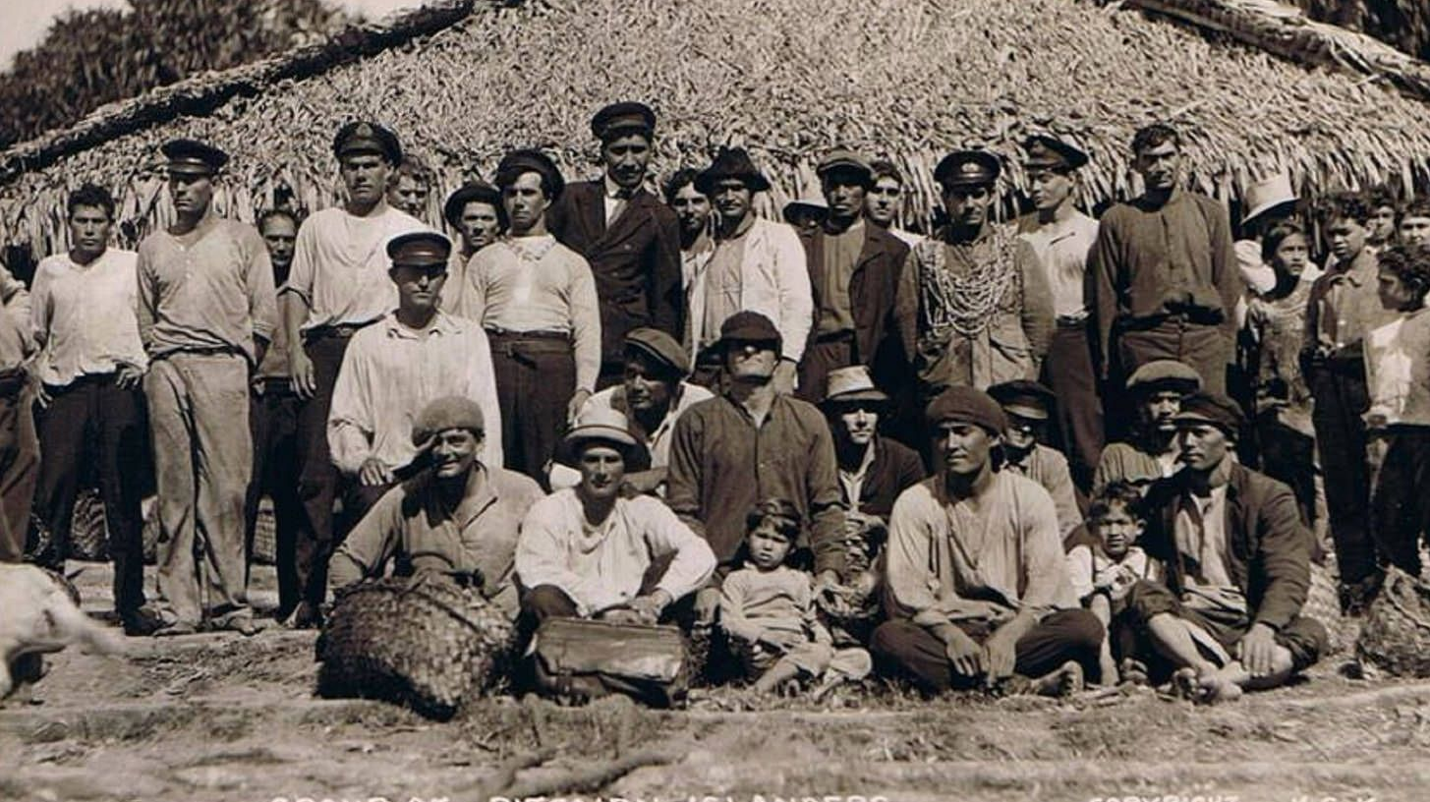
An Example of the Founder Effect:
The nine mutineers from the Bounty- together with six men and 12 women Polynesians from Tahiti were isolated on the Pitcairn island in 1790.
Due to the isolation, and the newcomers to the island the population’s gene pool has not changed drastically; showing less genetic diversity than the original parent populations.

Slide 8
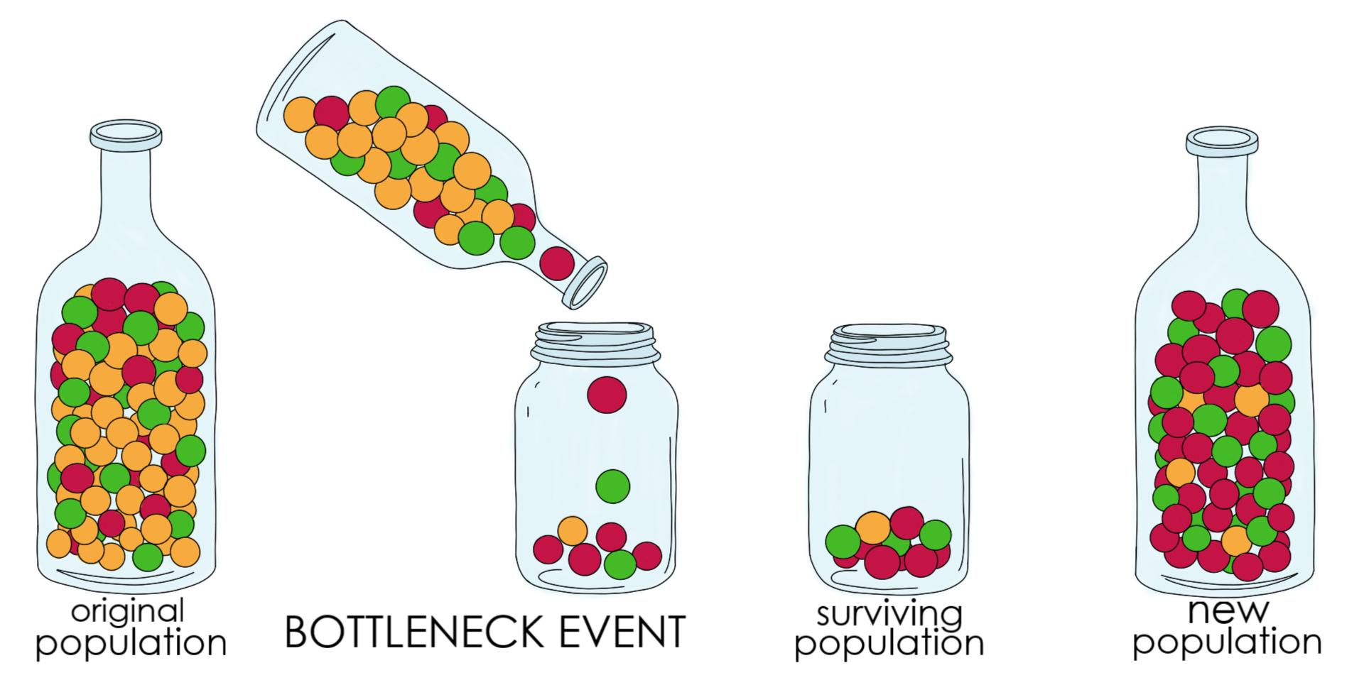
The Bottleneck Effect
A type of genetic drift, that is completely circumstanced based. It is when a random event occurs that drastically decreases a population, which causes genetic variation to go down and the allele frequency to change in a big way.

Slide 9
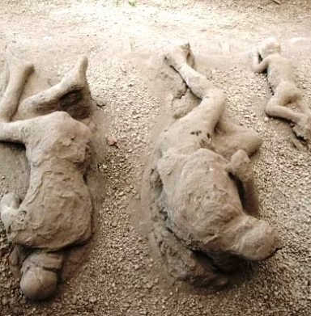
Bottleneck Effect Example:
The eruption of Mount Vesuvius covering Pompeii in ash would have caused a bottleneck effect in the Ancient Roman population, drastically reducing the allele frequency of the limited surviving population.

Slide 10
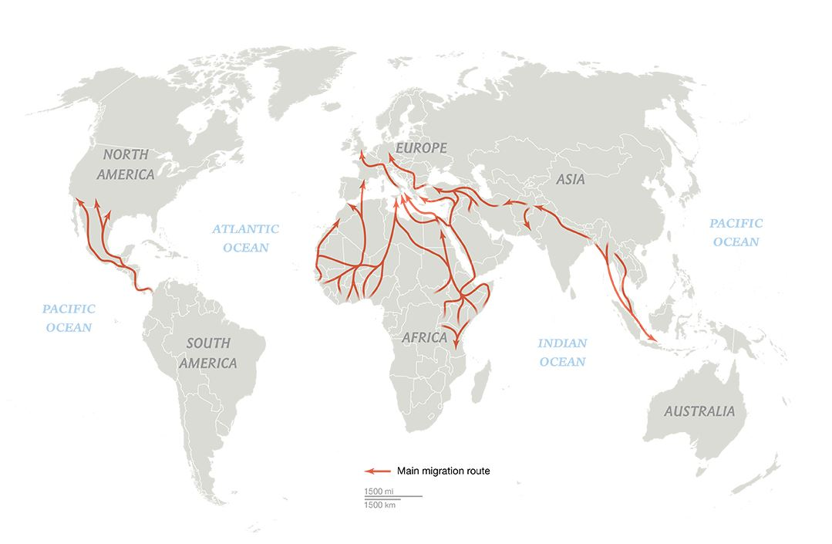
Migration:
Often described as gene flow from one population to another. Bring alleles from one country’s population into another, altering the frequencies of that population.

Slide 11
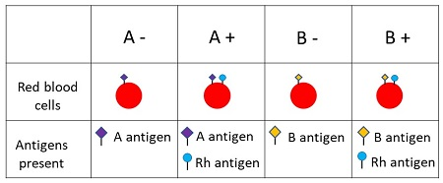
Example of Migration Effecting Gene Pools
Migration effected the Chinese Population. In the past China had Rh- positive blood group. The Rh or Rhesus factor is an antigen found on the surface of Red Blood Cells.
People with this Antigen are referred to as Rh+; those who don’t have it are Rh-. When European countries started to trade with China in the 16th century. They introduced the Rh- Allele into the population, however the allele frequency is still quite low.

Slide 12
Barriers to Gene Flow
Populations are often kept apart by barriers that inhibit the amount of interbreeding. As no two environments are completely the same, the environmental pressures will result in slightly different characteristics being formed. With isolation causing the development of completely different gene pools.
These have two types of barriers. Geographical Barriers (Allopatric Speciation) or Sociocultural Barriers (Sympatric Speciation)

Slide 13
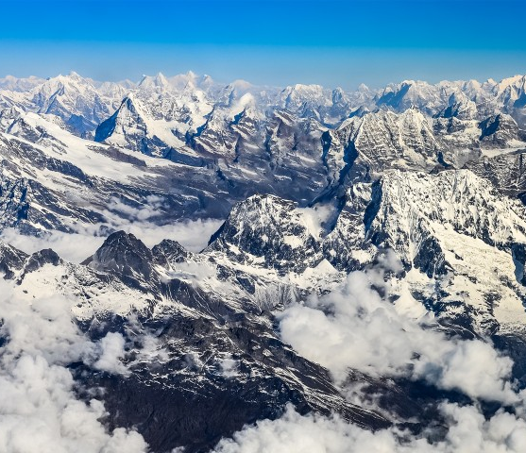
Allopatric Speciation
Allopatric Speciation when a new speciation occurs due to geographical separation.
This is the Gene Pool and allele frequencies differentiating over time to allow for new species to develop due to geographical separation.

Slide 14
Sympatric Speciation
Sociocultural divide preventing gene pools from mixing can enable sympatric speciation.
This is the gene pools becoming different despite not being separated physically.

Slide 15
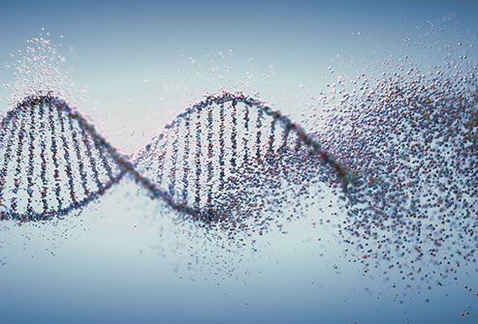
Genetic Diseases:
These result in changes to allele frequencies and gene pools. An allele causing an inherited fatal disease would be expected to be gradually eliminated from a population because people with the allele die and would not pass it on.

Slide 16
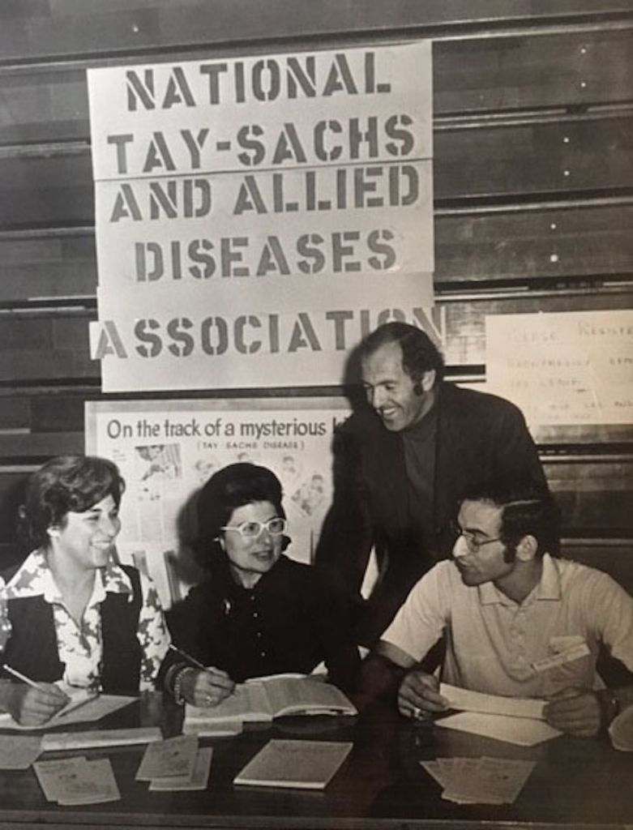
Case Study 1: Tay-Sachs Disease
Tay-Sachs Disease is a recessive hereditary disorder of lipid metabolism that occurs frequently in Jewish descent (Ashkenazi Jewish) from Eastern Europe. Tay-Sachs is caused by a missing enzyme that results in the accumulation of a fatty substance in the nervous system, gradually causing death by 4 or 5. However, heterozygote individuals who are carriers for this have an advantage as the same allele provides resistant to Tuberculosis.

Slide 17
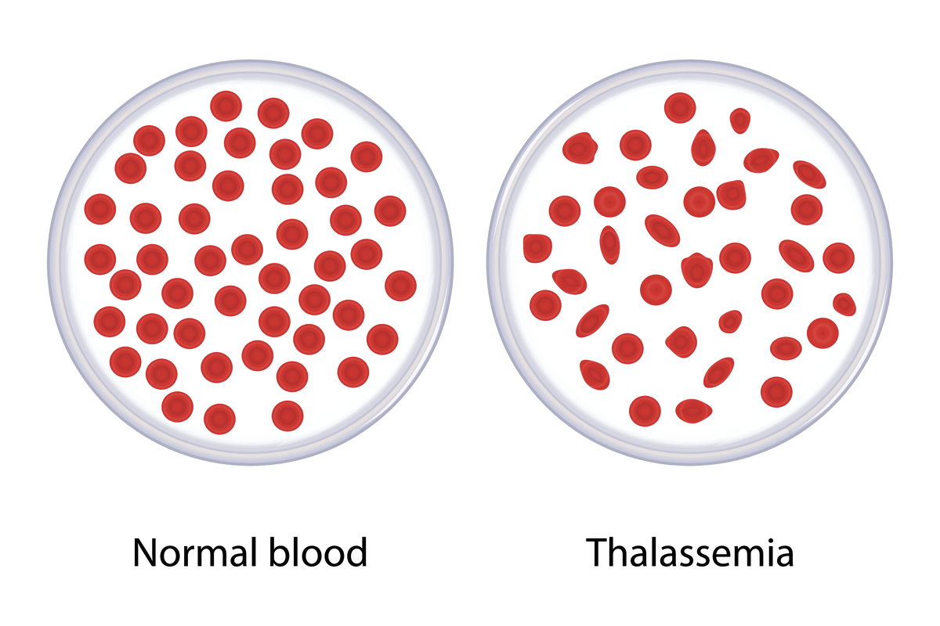
Case Study 2: Thalassaemia
Thalassaemia, a recessive disease in which anaemia results from defects in the formation of haemoglobin, with a relatively high rate of occurrence in populations that have the allele. Common in populations that come from Mediterranean origin (especially Greece and Italy). People with Thalassaemia require frequent blood transfusions throughout their life and special drugs to remove the excess iron that tends to build up in their bodies.

Slide 18
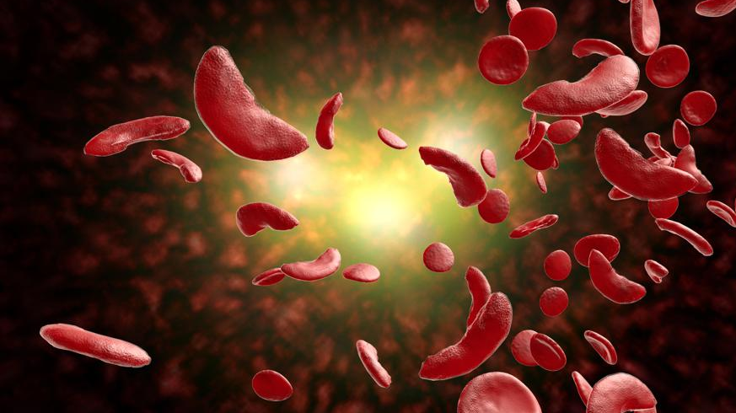
Case Study 3: Sickle-Cell Anaemia
Sickle-cell anaemia is another inherited disease. Occurring mainly in black Africans or those of black African descent. In the tropical zone of Africa 40% of the population carries this allele. This disease occurs when you inherit the allele from both parents, resulting in your red blood cells taking on a sickle appearance. The disease is usually fatal as the sickled red blood cells cannot carry as much oxygen as normal red blood cells. This condition however does have an advantage, providing immunity to malaria.

